Slide 1

Water and Soil Remediation in Environmental Pollution
Information Security Fundamentals | Environmental Pollution and Remediation
Course: Information Security Fundamentals | Chapter: Environmental Pollution and Remediation | Program: Bachelor of Engineering
DISCOVER · LEARN · EMPOWER
Notes:
Welcome students to our session on Water and Soil remediation. This topic is critical for understanding how human activities impact specific ecosystems. We will focus on the mechanisms of pollution and the engineering solutions available for remediation. Remember, our motto is Discover. Learn. Empower.

Slide 2
Course Outcomes
SLIDE 2 / 14
Course Outcome
CO | BT LEVEL | DESCRIPTION
CO1 | BT4 | Recall, analyze and respond on fundamental environmental principles, such as ecological relationships and conservation strategies
CO2 | BT4 | Understand and analyze the interconnections between human activities and environmental impacts across different ecosystems
CO3 | BT4 | Understand and analyze and apply environmental laws and policies to analyse and propose solutions for real-world environmental challenges.
CO4 | BT2 | Students will analyse data from environmental monitoring programs to assess trends and predict future impacts on ecosystems.
CO5 | BT6 | Interpret, elaborate and propose various tools, design and innovative strategies for sustainable development and environmental conservation initiatives in securing the planet.
Chandigarh University
2 / 14
Notes:
Today's lecture directly addresses Course Outcome 2. You will learn to analyze how industrial discharge affects water bodies and how agricultural runoff degrades soil quality. This analysis connects human actions directly to ecosystem health. By the end, you will understand the cause-and-effect relationships in these specific environments.

Slide 3
Learning Objectives
SLIDE 3 / 14
Learning Outcomes
1
Analyze the primary sources of water and soil contamination in industrial zones.
2
Evaluate the effectiveness of physical, chemical, and biological remediation techniques.
3
Calculate the required dosage of coagulants for treating turbid water samples.
4
Differentiate between in-situ and ex-situ methods for soil decontamination.
5
Assess the long-term ecological impacts of remediation failure scenarios.
Chandigarh University
3 / 14
Notes:
Our goals are to analyze sources, evaluate techniques, and calculate dosages. We will differentiate between cleaning soil in place versus removing it. Finally, we will assess what happens if these remediation strategies fail. These outcomes ensure you can apply theory to real-world engineering problems.

Slide 4
Lecture
SLIDE 4 / 14
Water Pollution Sources and Types
1
Point source pollution originates from discrete outlets like factory pipes.
2
Non-point source pollution comes from diffuse runoff like agricultural fields.
3
Thermal pollution reduces dissolved oxygen levels in aquatic ecosystems.
4
Eutrophication causes algal blooms that deplete oxygen in water bodies.
5
Heavy metals accumulate in sediments and enter the food chain.
Chandigarh University
4 / 14
Notes:
Point sources are easy to trace, like a pipe from a factory. Non-point sources are harder to control, like rain washing fertilizer off a farm. Thermal pollution from power plants lowers oxygen, killing fish. Eutrophication is a cycle where nutrients cause algae to bloom and then die, consuming oxygen. Heavy metals like lead persist in sediments for decades.

Slide 5
Lecture
SLIDE 5 / 14
Soil Pollution Mechanisms
1
Soil contamination occurs through industrial waste dumping and pesticide use.
2
Leaching allows soluble pollutants to migrate into groundwater aquifers.
3
Adsorption binds heavy metals to soil particles, reducing mobility.
4
Soil pH changes alter the solubility and toxicity of contaminants.
5
Microbial activity can degrade organic pollutants over time.
Chandigarh University
5 / 14
Notes:
Soil pollution often starts with industrial dumping or excessive pesticide application. Leaching is a major risk where chemicals dissolve and move down to groundwater. Adsorption acts as a buffer, holding metals to soil particles. The pH of the soil determines if these metals become toxic or stay locked away. Microbes play a vital role in breaking down organic waste naturally.

Slide 6
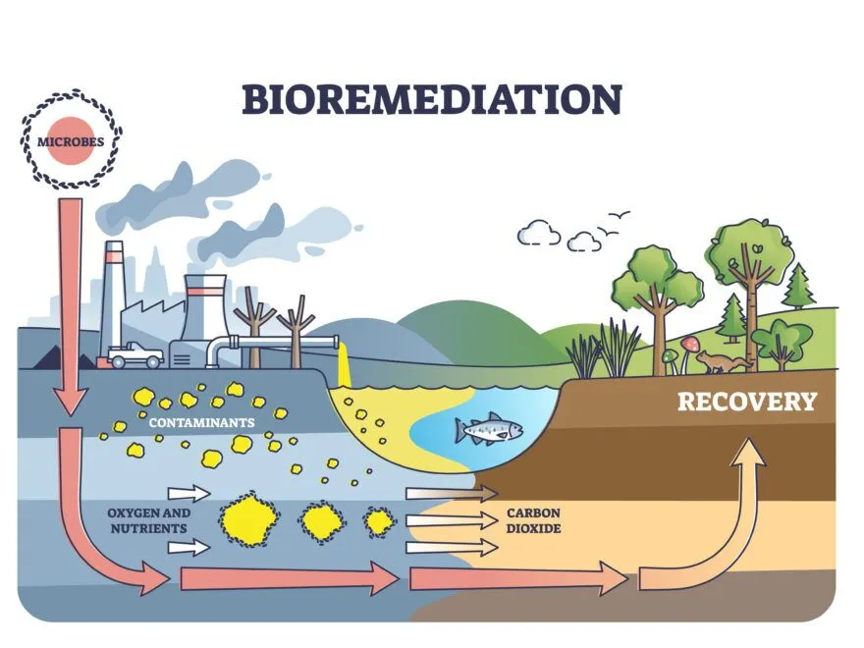
Lecture
SLIDE 6 / 14
Physical Remediation Techniques
1
Sedimentation removes suspended solids from wastewater through gravity.
2
Filtration uses sand or membrane barriers to trap particulate matter.
3
Soil washing physically separates contaminants from soil particles.
4
Excavation removes heavily contaminated soil for off-site treatment.
5
Air sparging injects air to volatilize organic compounds from soil.
Effective Strategies for Soil and Groundwater Remediation: A Comprehensive Guide | Douglas Partners (source: cdn-lhhad.nitrocdn.com)
Chandigarh University
6 / 14
Notes:
Physical methods rely on separation rather than chemical reactions. Sedimentation lets heavy particles settle out of water naturally. Filtration acts as a sieve for smaller particles. For soil, washing separates dirt from contaminants, while excavation removes the worst cases. Air sparging is like blowing bubbles to pull volatile chemicals out of the ground.

Slide 7
Lecture
SLIDE 7 / 14
Chemical Remediation Methods
1
Coagulation and flocculation aggregate fine particles for easier removal.
2
Chemical oxidation destroys organic pollutants using strong oxidants.
3
Precipitation converts dissolved metals into insoluble solid forms.
4
Neutralization adjusts pH to optimal levels for treatment processes.
5
Chemical stabilization locks contaminants in place to prevent leaching.
Chandigarh University
7 / 14
Notes:
Chemical methods change the nature of the pollutants. Coagulants like alum clump tiny particles together so they settle. Oxidation uses chemicals like ozone to break down toxic organics. Precipitation turns dissolved metals into solids that can be filtered out. Neutralization ensures the water is safe for discharge or reuse.

Slide 8
Lecture
SLIDE 8 / 14
Biological Remediation Strategies
1
Bioremediation uses microorganisms to degrade organic contaminants naturally.
2
Phytoremediation employs plants to absorb and stabilize soil toxins.
3
Composting accelerates the breakdown of organic waste in soil.
4
Bioaugmentation adds specific bacterial strains to enhance degradation.
5
Constructed wetlands use plant roots to filter wastewater effectively.
Effective Strategies for Soil and Groundwater Remediation: A Comprehensive Guide | Douglas Partners (source: cdn-lhhad.nitrocdn.com)
Chandigarh University
8 / 14
Notes:
Biological methods use nature's own cleaners. Microbes eat organic pollutants, turning them into harmless byproducts. Plants can absorb toxins, a process called phytoremediation. We can add specific bacteria to speed up this process, known as bioaugmentation. Constructed wetlands are artificial marshes that filter water using plant roots.

Slide 9
Worked Example
SLIDE 9 / 14
Coagulant Dosage
GOVERNING EQUATION
Formula: Dose = (k × Turbidity) / 100
k = 1.5.
PROBLEM
Treat 5000 liters of water with 200 mg/L turbidity.
CALCULATION
Dose = (1.5 × 200) / 100 = 3 mg/L.
RESULT
15 grams of coagulant is needed for this batch.
• Total Chemical Required = 3 mg/L × 5000 L = 15,000 mg.
Chandigarh University
9 / 14
Notes:
Let's calculate the coagulant needed for a specific batch. If turbidity is 200 mg/L, we use a factor of 1.5. The dose comes out to 3 mg per liter. For 5000 liters, we multiply 3 by 5000 to get 15,000 milligrams. That equals 15 grams of chemical. This ensures the water clears effectively without overdosing.

Slide 10
Worked Example
SLIDE 10 / 14
Soil Leaching Rate
GOVERNING EQUATION
Formula: Mass_Lost = Rate × Total_Soil_Mass
PROBLEM
Calculate pollutant mass lost from 100 kg of soil.
GIVEN
Leaching rate is 0.05 kg pollutant per kg soil.
CALCULATION
Mass_Lost = 0.05 × 100 = 5 kg.
• Remaining Pollutant = 100 kg - 5 kg = 95 kg.
Chandigarh University
10 / 14
Notes:
Now consider soil leaching. If a soil sample weighs 100 kg and has a leaching rate of 0.05, we multiply them. The calculation shows 5 kg of pollutant is lost to groundwater. This means 95 kg remains in the soil. Understanding this rate helps engineers design barriers to stop the loss.

Slide 11
Lecture
SLIDE 11 / 14
Common Pitfalls in Remediation
1
Overlooking secondary pollution from chemical byproducts during treatment.
2
Ignoring seasonal variations in water flow and soil moisture levels.
3
Assuming all contaminants degrade at the same biological rate.
4
Failing to monitor pH changes that affect metal solubility.
5
Using inappropriate technology for the specific contaminant type.
Chandigarh University
11 / 14
Notes:
Students often make mistakes in remediation planning. A common error is ignoring secondary pollution from the chemicals used. Seasonal changes in water flow can drastically alter treatment efficiency. Not all contaminants degrade at the same speed, so assumptions can fail. Always monitor pH, as it controls whether metals stay dissolved or precipitate.

Slide 12
Lecture
SLIDE 12 / 14
Comparing Remediation Technologies
1
Physical methods are fast but generate solid waste sludge.
2
Chemical methods are effective but can be costly and hazardous.
3
Biological methods are eco-friendly but require long treatment ×.
4
In-situ methods save excavation costs but offer less control.
5
Ex-situ methods allow better monitoring but increase transport costs.
Effective Strategies for Soil and Groundwater Remediation: A Comprehensive Guide | Douglas Partners (source: cdn-lhhad.nitrocdn.com)
Chandigarh University
12 / 14
Notes:
Choosing the right technology depends on the trade-offs. Physical methods are quick but create sludge that needs disposal. Chemical methods work fast but can be expensive and dangerous. Biological methods are green but take a long time. In-situ is cheaper but harder to control, while ex-situ is more expensive but offers better oversight.

Slide 13
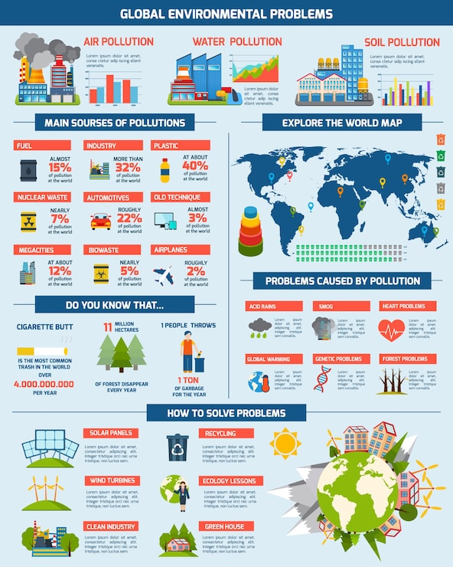
Lecture
SLIDE 13 / 14
Key Takeaways
1
Water and soil pollution stem from distinct point and non-point sources.
2
Remediation requires a mix of physical, chemical, and biological strategies.
3
Accurate dosage calculations are critical for effective and safe treatment.
4
Soil pH and microbial activity dictate the success of biological cleanup.
5
Selecting the right technology depends on cost, time, and contaminant type.
Source: img.magnific.com
Chandigarh University
13 / 14
Notes:
To summarize, pollution comes from various sources requiring specific solutions. We must combine physical, chemical, and biological methods for best results. Precise calculations ensure we treat water and soil effectively without waste. The success of biological cleanup relies heavily on pH and microbes. Finally, technology selection is a balance of cost, time, and the specific contaminant.

Slide 14
Lecture
SLIDE 14 / 14
References
ENVIRONMENTAL STUDIES
From Crisis to Cure — R. Rajagopalan
• Environmental Science and Engineering — Benny Joseph
• Environmental Studies — R.C. Sharma and D. Gurbir Sangha
• Introduction to Environmental Science — Anjaneyulu, Y.
• Environmental Pollution Control Engineering — C.S. Rao
• Textbook of Environmental Studies for undergraduate courses — E. Bharucha
• Environmental Science — S.C. Santra
Chandigarh University
14 / 14
Notes:
These seven textbooks provide the foundational knowledge for this lecture. Benny Joseph and R.C. Sharma offer comprehensive guides on environmental engineering. Anjaneyulu and C.S. Rao provide specific insights into pollution control. E. Bharucha and R. Rajagopalan discuss the broader crisis and solutions. S.C. Santra's work rounds out our essential reading list.

